Slide 1
Exploratory Data Analysis (EDA)
Unit 3

Slide 2
Elements of Structured data
Data comes from many sources such as sensors, text, images, videos, and IoT streams, and much of it is unstructured in nature.
A major challenge of data science is transforming this massive amount of raw data into meaningful and actionable information.

Slide 3
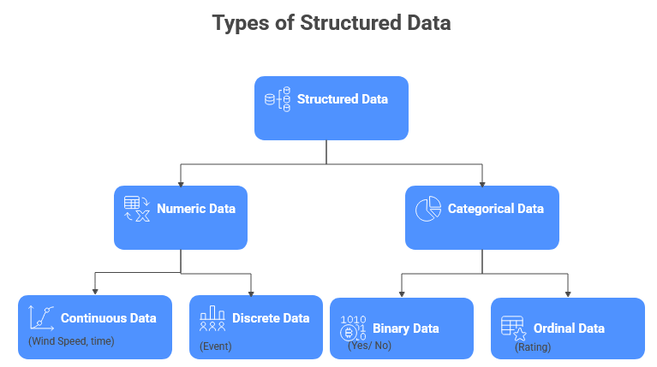

Slide 4
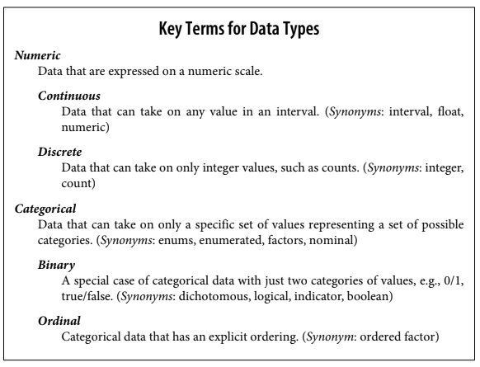

Slide 5
Software engineers and database programmers may question the need to distinguish categorical and ordinal data in analytics, since categories are simply text or numeric values managed by databases.
However, explicitly identifying data as categorical rather than plain text offers several advantages.
• Knowing that data is categorical can act as a signal telling software how statistical procedures, such as producing a chart or fitting a model, should behave. In particular, ordinal data can be represented as an ordered.factor in R, preserving a user-specified ordering in charts, tables, and models. In Python, scikit-learn supports ordinal data with the sklearn.preprocessing.OrdinalEncoder.
• Storage and indexing can be optimized (as in a relational database).
• The possible values a given categorical variable can take are enforced in the software (like an enum).

Slide 6
Rectangular Data
The typical frame of reference for an analysis in data science is a rectangular data object, like a spreadsheet or database table.
Rectangular data is the general term for a two-dimensional matrix with rows indicating records (cases) and columns indicating features (variables); data frame is the specific format in R and Python.
The data doesn’t always start in this form: unstructured data (e.g., text) must be processed and manipulated so that it can be represented as a set of features in the rectangular data.
Data in relational databases must be extracted and put into a single table for most data analysis and modeling tasks.

Slide 7
Key Terms for Rectangular Data
Data frame: Rectangular data (like a spreadsheet) is the basic data structure for statistical and machine learning models.
Feature: A column within a table is commonly referred to as a feature.
Outcome: Many data science projects involve predicting an outcome—often a yes/no outcome. The features are sometimes used to predict the outcome in an experiment or a study.
Records: A row within a table is commonly referred to as a record.

Slide 8
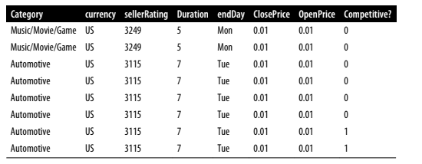
Example

Slide 9
contd…
Traditional database tables use index columns to improve query efficiency.
Similarly, Python’s pandas DataFrame automatically creates an integer index and also supports multilevel (hierarchical) indexes for better performance.
In R, a data.frame has a default integer index but does not support user-defined or multilevel indexes; however, packages like data.table and dplyr add this capability and improve processing speed.

Slide 10
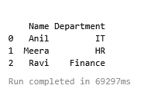
Example
import pandas as pd
data = {
"Name": ["Anil", "Meera", "Ravi"],
"Department": ["IT", "HR", "Finance"]
}
df = pd.DataFrame(data)
print(df)

Slide 11
Nonrectangular Data Structures
Besides rectangular data, other important data structures exist in data science.
Time series data records measurements of a variable over time and is widely used in forecasting and IoT data.
Spatial data structures are used in mapping and location analytics, representing objects with coordinates or values across spatial units.
Graph (network) data structures model relationships between entities, such as social networks or transportation networks, and are useful for tasks like network optimization and recommender systems.
However, rectangular data remains the fundamental structure for predictive modeling.

Slide 12
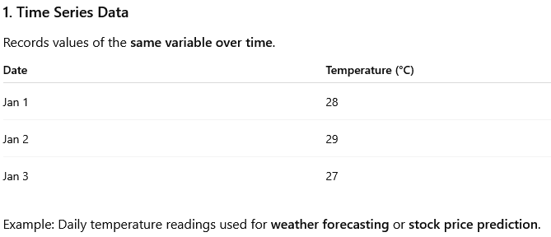

Slide 13
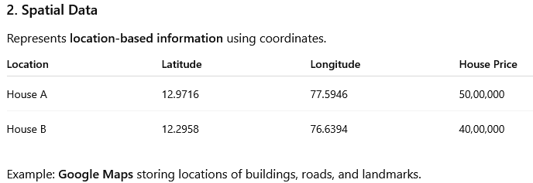

Slide 14
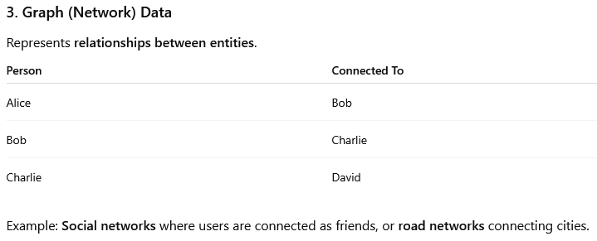

Slide 15
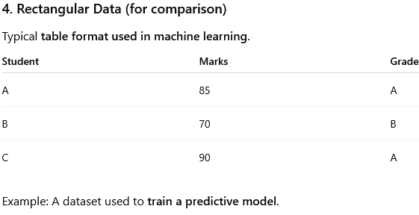

Slide 16
Key Terms for Estimates of Location
Mean / Average: The sum of all values divided by the number of values.
Weighted mean/ weighted average: The sum of all values times a weight divided by the sum of the weights.
Median (50th percentile): The value such that one-half of the data lies above and below.
Percentile / quantile: The value such that P percent of the data lies below.

Slide 17
Weighted median: The value such that one-half of the sum of the weights lies above and below the sorted data.
Trimmed mean / truncated mean: The average of all values after dropping a fixed number of extreme values.
Robust / resistant: Not sensitive to extreme values.
Outlier / extreme value: A data value that is very different from most of the data.

Slide 18
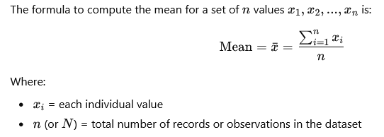
Mean / Average
The most basic estimate of location is the mean, or average value.
The mean is the sum of all values divided by the number of values.
Consider the following set of numbers: {3 5 1 2}. The mean is (3 + 5 + 1 + 2) / 4 = 11 / 4 = 2.75.

Slide 19
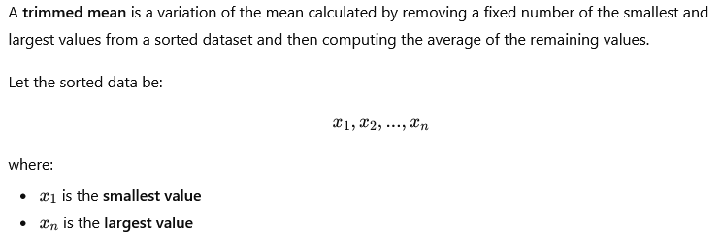

Trimmed Mean

Slide 20
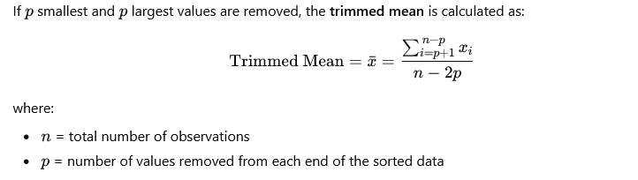
contd…

Slide 21
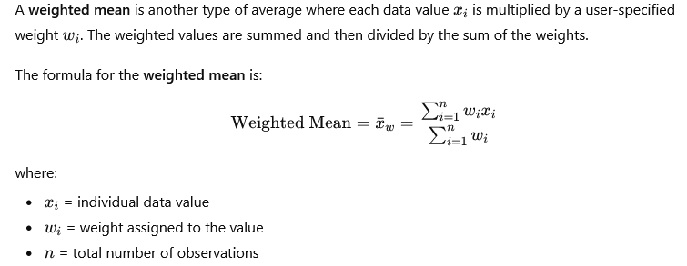
Weighted Mean

Slide 22
Reasons for Using a Weighted Mean
There are two main reasons for using a weighted mean:
1. Different variability in observations Some values are more variable or less reliable than others. In such cases, less reliable observations are assigned lower weights. Example: When averaging readings from multiple sensors, a less accurate sensor may be given a smaller weight.
2. Unequal representation of groups Sometimes collected data does not equally represent all groups of interest. To correct this imbalance, higher weights can be assigned to underrepresented groups. Example: In an online experiment, if certain user groups are underrepresented, their data can be given higher weights to obtain a more accurate overall estimate.

Slide 23
Median
The median is the middle value in a sorted dataset.
If the number of observations is even, it is calculated as the average of the two middle values.
Unlike the mean, which uses all observations, the median depends only on the central values and is therefore less affected by extreme values (outliers).
For example, when measuring typical household income, the median provides a better representation because very high incomes do not distort the result.
A weighted median can also be calculated when each data value has a weight; it is the value where the sum of weights on both sides of the sorted data is equal, and it is also robust to outliers.

Slide 24
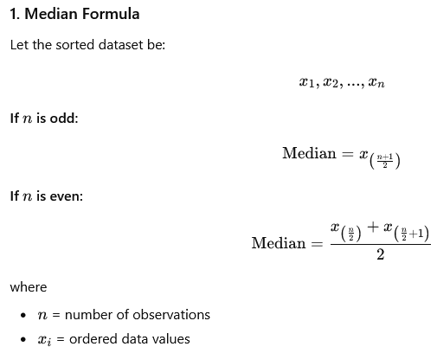

Slide 25
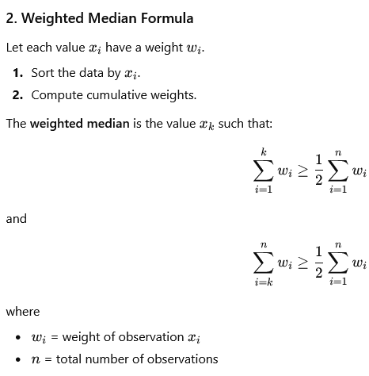

Slide 26
Outliers
An outlier is a value that is very far from the other observations in a dataset.
The median is considered a robust measure of location because it is not greatly affected by such extreme values, unlike the mean which can be distorted.
Outliers are not always errors; they may represent valid but unusual cases (e.g., extremely high income). However, they are often caused by data errors, such as incorrect units or faulty sensor readings. Therefore, outliers should always be identified and investigated during data analysis.

Slide 27
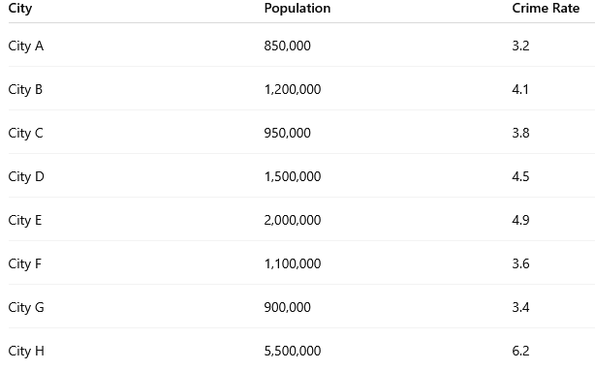
Example: Location Estimates of Population and Crime Rates

Slide 28
Using the population values, compute the following:
Mean population of the cities.
Median population.
Trimmed mean population
Solution:
1. Sort the Data
2. Mean (Average)
Mean population = 1,750,000
3. Median population = 1,150,000
4. Trimmed Mean = 1,275,000

Slide 29
Estimates of Variability
Location is just one dimension in summarizing a feature.
A second dimension, variability, also referred to as dispersion, measures whether the data values are tightly clustered or spread out.

Slide 30
Key Terms for Variability Metrics
Deviations/ errors/ residuals: The difference between the observed values and the estimate of location.
Variance / mean-squared-error: The sum of squared deviations from the mean divided by n – 1 where n is the number of data values.
Standard deviation: The square root of the variance.
Mean absolute deviation / l1-norm, Manhattan norm: The mean of the absolute values of the deviations from the mean.
Median absolute deviation from the median: The median of the absolute values of the deviations from the median.

Slide 31
Range: The difference between the largest and the smallest value in a data set.
Order statistics / ranks: Metrics based on the data values sorted from smallest to biggest.
Percentile / quantile: The value such that P percent of the values take on this value or less and (100–P) percent take on this value or more.
Interquartile range / IQR: The difference between the 75th percentile and the 25th percentile.

Slide 32
Standard Deviation and Related Estimates
The most widely used estimates of variation are based on the differences, or deviations, between the estimate of location and the observed data.
For a set of data {1, 4, 4}, the mean is 3 and the median is 4.
The deviations from the mean are the differences:
1 – 3 = –2,
4 – 3 = 1,
4 – 3 = 1.
These deviations tell us how dispersed the data is around the central value.

Slide 33
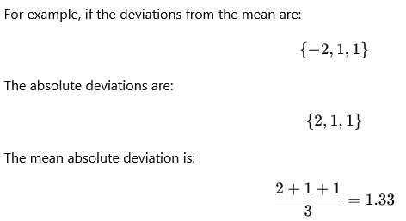
One way to measure variability is to estimate a typical value of the deviations from the mean. Simply averaging the deviations is not useful because negative deviations cancel positive deviations, making their total equal to zero.
A simple solution is to calculate the average of the absolute deviations from the mean. This measure is called the Mean Absolute Deviation (MAD).

Slide 34
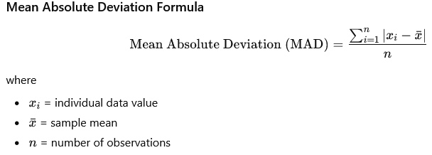

Slide 35
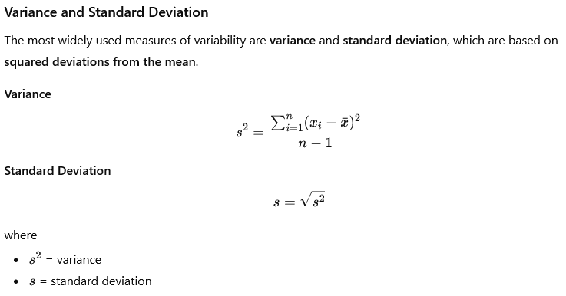

Slide 36
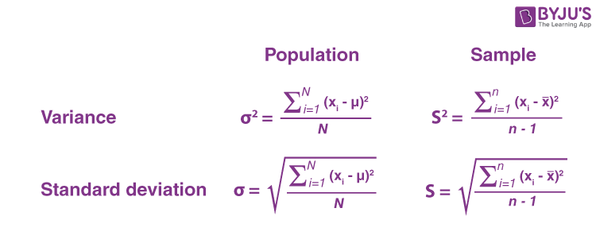

Slide 37
Robust Measures of Variability
The variance, standard deviation, and mean absolute deviation are not robust to outliers or extreme values. This is especially true for variance and standard deviation because they use squared deviations, which increase the influence of extreme observations.
A more robust measure of variability is the Median Absolute Deviation (MAD), which is based on deviations from the median instead of the mean.

Slide 38
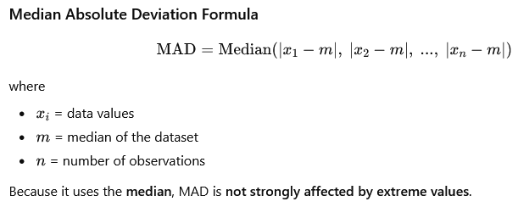

Slide 39
Estimates Based on Percentiles
Another way to measure dispersion (variability) is by examining the spread of sorted data. Statistics calculated from sorted or ranked data are called order statistics.
The simplest measure is the range, which is the difference between the maximum and minimum values in the dataset:
Range= Maximum − Minimum
Although the minimum and maximum values help identify outliers, the range is very sensitive to extreme values and is not always a reliable measure of variability.

Slide 40
To reduce the effect of outliers, dispersion can be measured using percentiles.
The Pth percentile is the value below which P% of the observations fall.
For example, the 50th percentile is the median, and the 80th percentile is the value below which 80% of the data lies.
A commonly used measure of variability based on percentiles is the Interquartile Range (IQR), which measures the spread of the middle 50% of the data:
IQR= Q3 − Q1
where
Q1​ = 25th percentile
Q3 = 75th percentile
For very large datasets, calculating exact percentiles can be computationally expensive because it requires sorting the entire dataset. Therefore, statistical and machine learning software often use approximation algorithms to estimate percentiles quickly while maintaining acceptable accuracy.

Slide 41
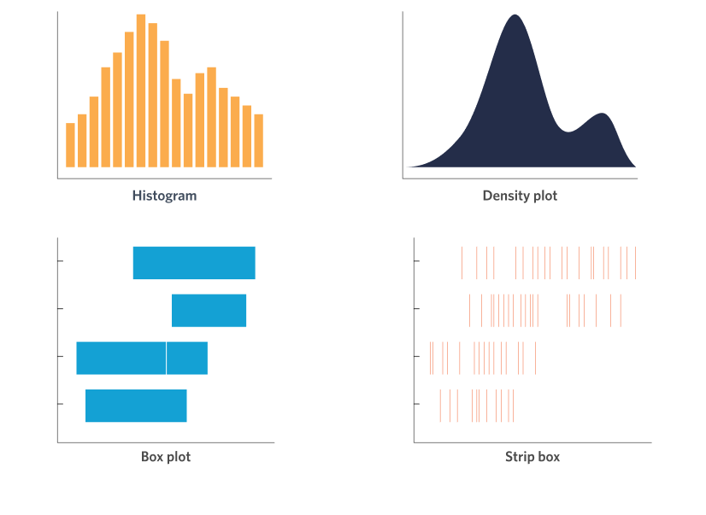
Exploring the Data Distribution

Slide 42
Exploring the Data Distribution
Boxplot / box and whiskers plot : A plot introduced as a quick way to visualize the distribution of data.
Frequency table: A tally of the count of numeric data values that fall into a set of intervals (bins).
Histogram: A plot of the frequency table with the bins on the x-axis and the count (or proportion) on the y-axis. While visually similar, bar charts should not be confused with histograms.
Density plot: A smoothed version of the histogram, often based on a kernel density estimate.

Slide 43
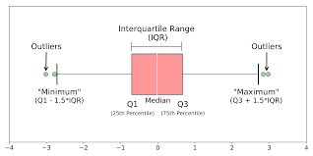
A boxplot (or box-and-whisker plot) is a standardized graphical method for displaying the distribution of numerical data based on a five-number summary: minimum, first quartile (Q1), median (Q2), third quartile (Q3), and maximum. It highlights the data’s spread, central tendency, skewness, and potential outliers.

Slide 44
Percentiles and Boxplots
Percentiles are useful not only for measuring spread but also for summarizing the entire distribution of data.
1. Common Percentiles Used Some commonly reported percentiles are:
Quartiles:
25th percentile (Q1)
50th percentile (Median)
75th percentile (Q3)
Deciles:
10th, 20th, 30th, …, 90th percentiles
Percentiles help describe the tails of the distribution (extreme low and high values). For example, the phrase “one-percenters” refers to people in the top 1% (99th percentile) of wealth.

Slide 45
import pandas as pd
import matplotlib.pyplot as plt
# Create dataset
data = {
'Murder_Rate': [1.6, 2.4, 2.8, 3.1, 3.7, 4.0, 4.5, 5.2, 5.8, 6.1, 6.5] #dictionary with 1 col.
}
state = pd.DataFrame(data)
# Calculate percentiles
percentiles = state['Murder_Rate'].quantile([0.05, 0.25, 0.50, 0.75, 0.95])
print("Percentiles:")
print(percentiles)
# Create boxplot
ax = state['Murder_Rate'].plot.box()
ax.set_ylabel("Murder Rate per 100,000 people")
plt.show()

Slide 46
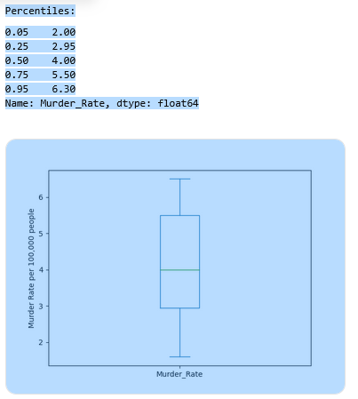

Slide 47
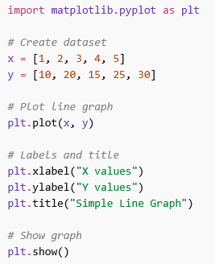
Example program 1

Slide 48
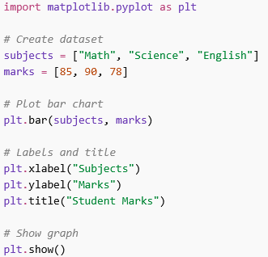
Bar chart Example

Slide 49
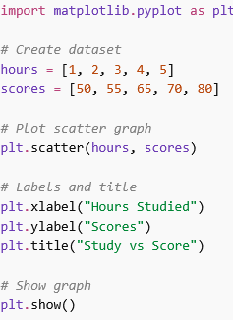
Scatter plot example

Slide 50
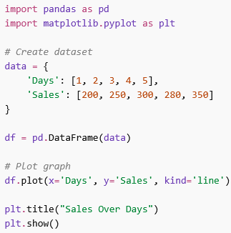
Using Pandas Dataset

Slide 51
Try it yourself
Write a Python program to create two lists representing days and temperatures, and plot a line graph showing temperature variation over days.
Create a dataset of monthly expenses and plot a line graph. Label the axes and give a suitable title.
Write a Python program to create a dataset of students and their marks in three subjects and display it using a bar chart.
Plot a bar graph to compare sales of different products in a shop.
Create a dataset of hours studied and marks scored, and plot a scatter graph.
Write a program to show the relationship between age and height using a scatter plot.
Create a dataset using Pandas for daily sales and plot a line graph.
Write a Python program to create a DataFrame with employee salaries and plot a bar chart.

Slide 52
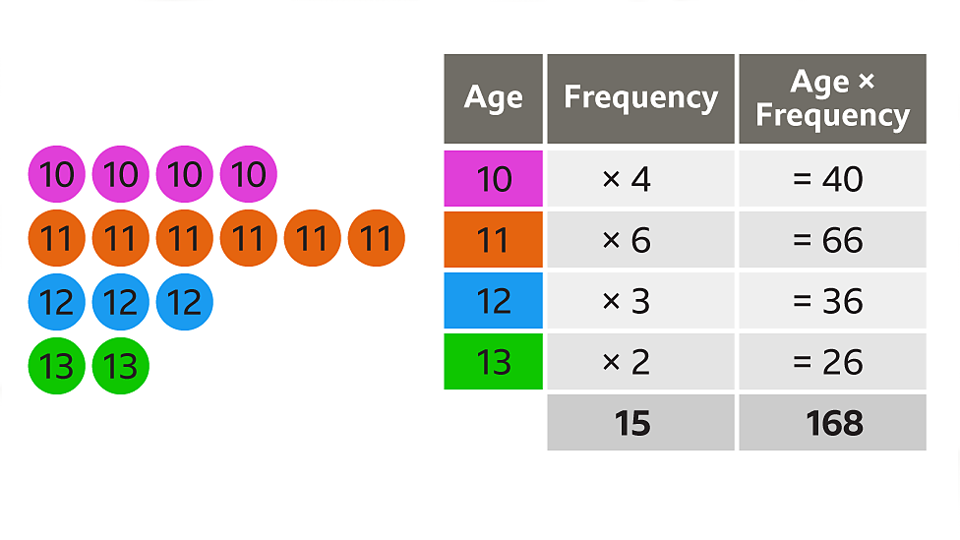
Frequency table

Slide 53
Density Plots and Estimates
A density plot is used to show the distribution of data values as a smooth continuous curve. It is closely related to a histogram.
A histogram displays the distribution using bars (bins) that show counts or frequencies.
A density plot shows the distribution as a smoothed curve.
Because of this, a density plot is often described as a smoothed histogram. It is usually calculated using a method called Kernel Density Estimation (KDE).

Slide 54
Key Characteristics of Density Plots
Smooth curve representing the distribution of data.
The total area under the curve equals 1.
The y-axis represents probability density, not counts.
The area between two points on the x-axis represents the proportion of data in that range.
For example, the area under the curve between x = 2 and x = 5 represents the fraction of observations whose values fall between 2 and 5.

Slide 55
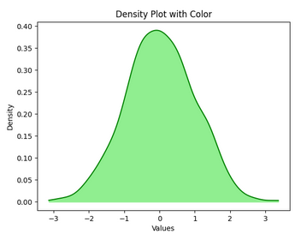
import numpy as np
import matplotlib.pyplot as plt
from scipy.stats import gaussian_kde
data = np.random.randn(1000)
kde = gaussian_kde(data)
x = np.linspace(min(data), max(data), 1000)
plt.plot(x, kde(x), color='green')
plt.fill_between(x, kde(x), color='lightgreen')
plt.title("Density Plot with Color")
plt.xlabel("Values")
plt.ylabel("Density")
plt.show()

Slide 56
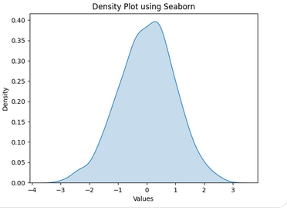
import numpy as np
import seaborn as sns
import matplotlib.pyplot as plt
data = np.random.randn(1000)
plt.figure()
sns.kdeplot(data, fill=True)
plt.title("Density Plot using Seaborn")
plt.xlabel("Values")
plt.show()

Slide 57
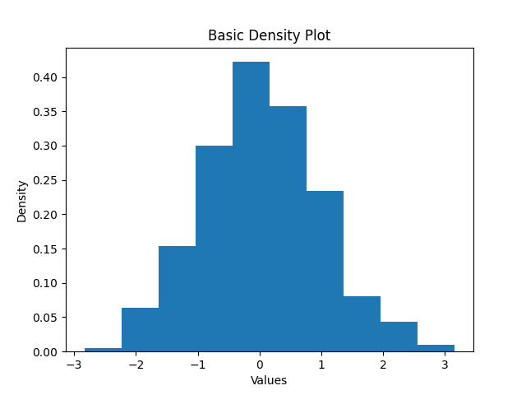
import numpy as np
import matplotlib.pyplot as plt
# Generate data
data = np.random.randn(1000)
# Plot density
plt.figure()
data_series = sorted(data)
# Simple KDE using histogram approximation
plt.hist(data, density=True)
plt.title("Basic Density Plot")
plt.xlabel("Values")
plt.ylabel("Density")
plt.show()

Slide 58
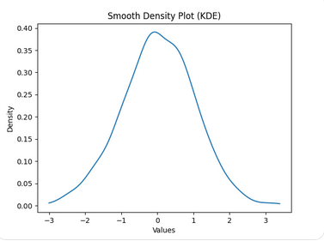
import numpy as np
import matplotlib.pyplot as plt
from scipy.stats import gaussian_kde
# Data
data = np.random.randn(1000)
# KDE
kde = gaussian_kde(data)
x = np.linspace(min(data), max(data), 1000)
plt.figure()
plt.plot(x, kde(x))
plt.title("Smooth Density Plot (KDE)")
plt.xlabel("Values")
plt.ylabel("Density")
plt.show()

Slide 59
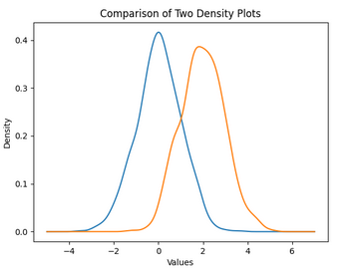
import numpy as np
import matplotlib.pyplot as plt
from scipy.stats import gaussian_kde
# Two datasets
data1 = np.random.randn(1000)
data2 = np.random.randn(1000) + 2 # shifted
kde1 = gaussian_kde(data1)
kde2 = gaussian_kde(data2)
x = np.linspace(-5, 7, 1000)
plt.figure()
plt.plot(x, kde1(x))
plt.plot(x, kde2(x))
plt.title("Comparison of Two Density Plots")
plt.xlabel("Values")
plt.ylabel("Density")
plt.show()

Slide 60
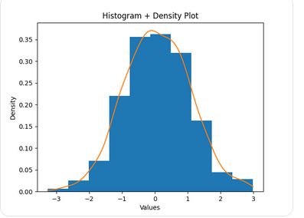
import numpy as np
import matplotlib.pyplot as plt
from scipy.stats import gaussian_kde
data = np.random.randn(1000)
kde = gaussian_kde(data)
x = np.linspace(min(data), max(data), 1000)
plt.figure()
plt.hist(data, density=True)
plt.plot(x, kde(x))
plt.title("Histogram + Density Plot")
plt.xlabel("Values")
plt.ylabel("Density")
plt.show()

Slide 61
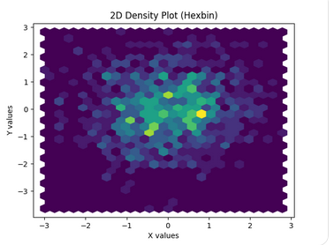
import numpy as np
import matplotlib.pyplot as plt
# Generate 2D data
x = np.random.randn(1000)
y = np.random.randn(1000)
plt.figure()
plt.hexbin(x, y, gridsize=25)
plt.xlabel("X values")
plt.ylabel("Y values")
plt.title("2D Density Plot (Hexbin)")
plt.show()

Slide 62
Exploring Binary and Categorical Data
Mode: The most commonly occurring category or value in a dataset.
Expected Value: When the categories can be associated with a numeric value, it gives an average value based on the probability of occurence of a category.
Bar Charts: The frequency or proportion for each category plotted as bars.
Pie Charts: The frequency or proportion for each category plotted as wedges in a pie.

Slide 63
Mode
The mode is the value, or values in case of a tie, that appears most often in the data.
For example: In most parts of the United States, the mode for religious preference would be Christian.
The mode is a simple summary statistic for categorical data, and it is generally not used for numeric data.

Slide 64
A special type of categorical data occurs when the categories can be linked to numerical values on the same scale, allowing them to be analyzed mathematically.
For example, a marketer offering two cloud service plans—one priced at $300 per month and another at $50 per month—observes that 5% of webinar attendees choose the $300 plan, 15% choose the $50 plan, and 80% do not purchase anything.
Although these are categories, they can be converted into numerical outcomes (300, 50, and 0) and combined using probabilities.

Slide 65
This leads to the concept of expected value, which is a weighted average where each outcome is multiplied by its probability and then summed.
In this case, the expected value is calculated as
(0.05 × 300) + (0.15 × 50) + (0.80 × 0) = 22.5,
meaning each attendee is worth $22.50 on average per month.
Expected value helps businesses estimate future returns and supports decision-making in areas such as budgeting, forecasting, and investment planning.

Slide 66
Probability
Probability refers to how likely an event is to occur, a concept most people understand from everyday situations like weather forecasts (chance of rain) or sports predictions (chance of a team winning).
In simple terms, probability can be understood as the proportion of times an event would happen if the same situation were repeated many times under identical conditions.

Slide 67
Correlation
Exploratory data analysis in many modeling projects (whether in data science or in research) involves examining correlation among predictors, and between predictors and a target variable.
Variables X and Y (each with measured data) are said to be positively correlated if high values of X go with high values of Y, and low values of X go with low values of Y. If high values of X go with low values of Y, and vice versa, the variables are negatively correlated.
Ex: Study hours vs Marks, Temperature vs Ice Cream sales

Slide 68
Key Terms for Correlation
Correlation coefficient: A metric that measures the extent to which numeric variables are associated with one another (ranges from –1 to +1).
Correlation matrix: A table where the variables are shown on both rows and columns, and the cell values are the correlations between the variables.
Scatterplot: A plot in which the x-axis is the value of one variable, and the y-axis the value of another.

Slide 69
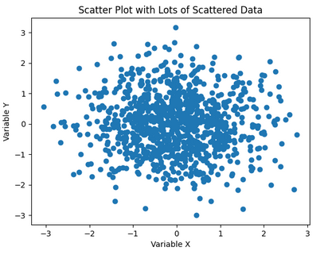
Scatterplots
The standard way to visualize the relationship between two measured data variables is with a scatterplot. The x-axis represents one variable and the y-axis another, and each point on the graph is a record.

Slide 70
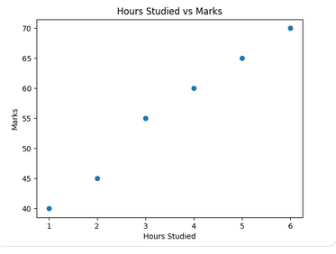
import pandas as pd
import matplotlib.pyplot as plt
# Create dataset
data = {
'Hours_Studied': [1, 2, 3, 4, 5, 6],
'Marks': [40, 45, 55, 60, 65, 70]
}
df = pd.DataFrame(data)
# Scatter plot
plt.figure()
plt.scatter(df['Hours_Studied'], df['Marks'])
# Labels and title
plt.xlabel('Hours Studied')
plt.ylabel('Marks')
plt.title('Hours Studied vs Marks')
plt.show()

Slide 71
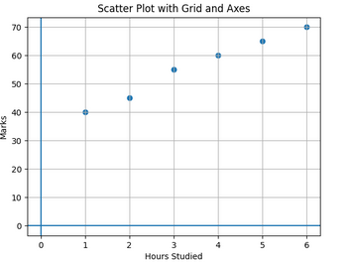
import pandas as pd
import matplotlib.pyplot as plt
data = {
'Hours_Studied': [1, 2, 3, 4, 5, 6],
'Marks': [40, 45, 55, 60, 65, 70]
}
df = pd.DataFrame(data)
plt.figure()
plt.scatter(df['Hours_Studied'], df['Marks'])
# Add grid
plt.grid()
# Add axis lines at 0
plt.axhline(0)
plt.axvline(0)
plt.xlabel('Hours Studied')
plt.ylabel('Marks')
plt.title('Scatter Plot with Grid and Axes')
plt.show()

Slide 72
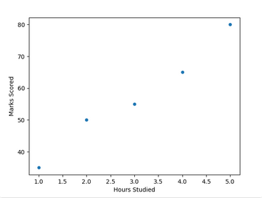
import pandas as pd
import matplotlib.pyplot as plt
data = {
'Hours': [1, 2, 3, 4, 5],
'Marks': [35, 50, 55, 65, 80]
}
df = pd.DataFrame(data)
ax = df.plot.scatter(x='Hours', y='Marks')
ax.set_xlabel('Hours Studied')
ax.set_ylabel('Marks Scored')
plt.show()

Slide 73
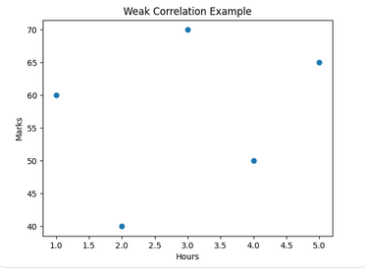
import pandas as pd
import matplotlib.pyplot as plt
data = {
'Hours': [1, 2, 3, 4, 5],
'Marks': [60, 40, 70, 50, 65]
}
df = pd.DataFrame(data)
plt.figure()
plt.scatter(df['Hours'], df['Marks'])
plt.xlabel('Hours')
plt.ylabel('Marks')
plt.title('Weak Correlation Example')
plt.show()

Slide 74
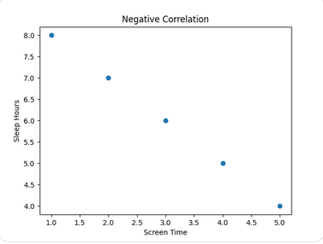
import pandas as pd
import matplotlib.pyplot as plt
data = {
'Screen_Time': [1, 2, 3, 4, 5],
'Sleep_Hours': [8, 7, 6, 5, 4]
}
df = pd.DataFrame(data)
plt.figure()
plt.scatter(df['Screen_Time'], df['Sleep_Hours'])
plt.xlabel('Screen Time')
plt.ylabel('Sleep Hours')
plt.title('Negative Correlation')
plt.show()

Slide 75
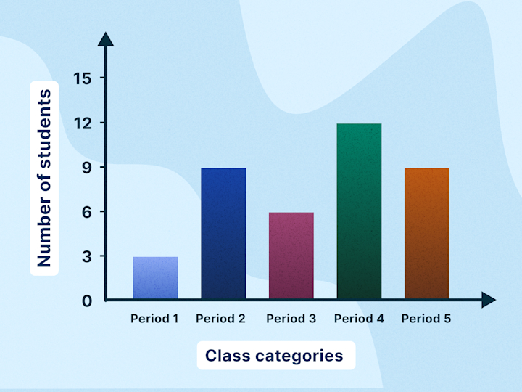
Bar Chart
A bar chart represents categorical data using rectangular bars where the length/height of each bar corresponds to the value.
🔹 Key Points:
Used for comparison between categories
Categories on X-axis, values on Y-axis
Bars can be vertical or horizontal
🔹 Example Use:
Comparing marks of students in different subjects

Slide 76
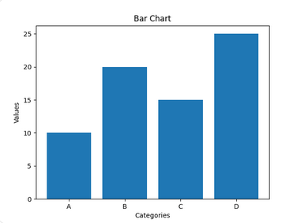
Bar Chart
import matplotlib.pyplot as plt
categories = ['A', 'B', 'C', 'D']
values = [10, 20, 15, 25]
plt.bar(categories, values)
plt.xlabel("Categories")
plt.ylabel("Values")
plt.title("Bar Chart")
plt.show()

Slide 77
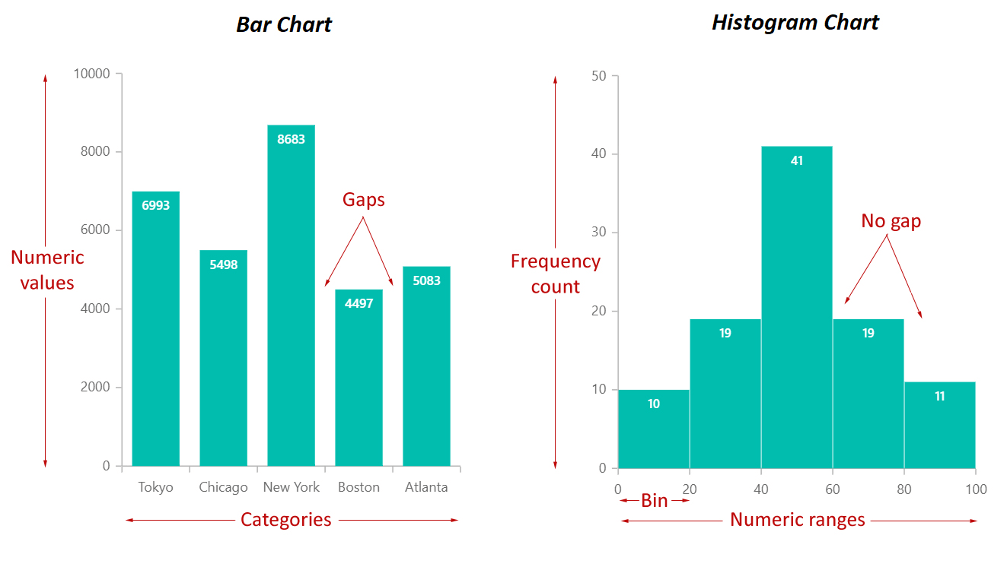

Slide 78
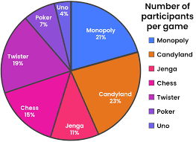
Pie chart
A pie chart shows data as parts of a whole using slices of a circle.
🔹 Key Points:
Each slice represents a percentage
Total always equals 100%
Best for showing proportions
🔹 Example Use:
Market share of companies

Slide 79
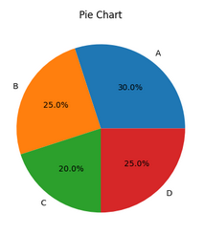
Pie chart
import matplotlib.pyplot as plt
labels = ['A', 'B', 'C', 'D']
sizes = [30, 25, 20, 25]
plt.pie(sizes, labels=labels, autopct='%1.1f%%')
plt.title("Pie Chart")
plt.show()

Slide 80
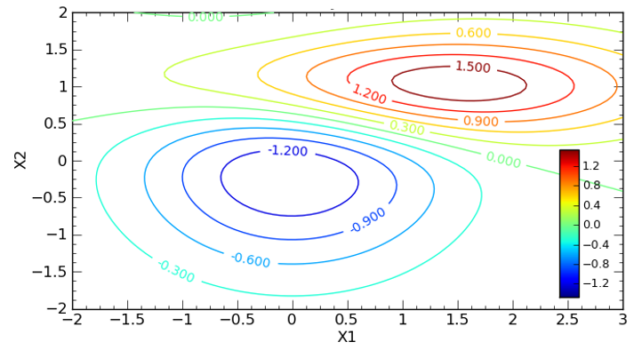
Contour Plot
A contour plot represents 3D data in 2D using contour lines.
🔹 Key Points:
Lines connect points of equal value
Used for surface visualization
Similar to geographical maps
🔹 Example Use:
Temperature distribution over an area

Slide 81
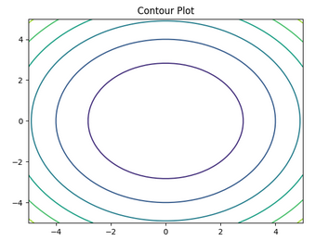
Contour Plot
import numpy as np
import matplotlib.pyplot as plt
x = np.linspace(-5, 5, 50)
y = np.linspace(-5, 5, 50)
X, Y = np.meshgrid(x, y)
Z = X**2 + Y**2
plt.contour(X, Y, Z)
plt.title("Contour Plot")
plt.show()

Slide 82
Correlation Matrix
A correlation matrix shows correlation values between multiple variables in tabular form.
🔹 Key Points:
Symmetric matrix
Diagonal values = 1
Helps identify relationships between many variables
🔹 Example Use:
Comparing multiple features in a dataset

Slide 83
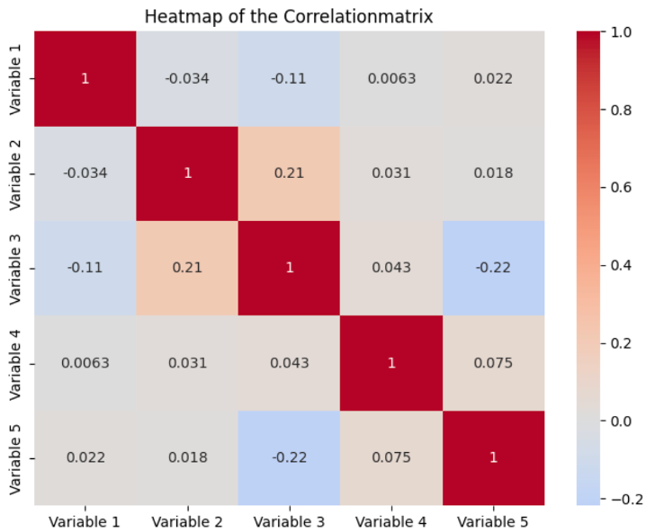

Slide 84
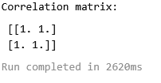
Correlation Matrix
import numpy as np
x = [1, 2, 3, 4, 5]
y = [2, 4, 6, 8, 10]
correlation = np.corrcoef(x, y)
print("Correlation matrix:\n", correlation)

Slide 85

Correlation Matrix
import pandas as pd
data = {
'A': [1, 2, 3, 4],
'B': [2, 4, 6, 8],
'C': [5, 6, 7, 8]
}
df = pd.DataFrame(data)
print(df.corr())

Slide 86

Heat Maps
A heat map is a graphical representation of data using colors.
🔹 Key Points:
Colors indicate magnitude
Often used with correlation matrix
Easy visual interpretation
🔹 Example Use:
Visualizing correlations in datasets

Slide 87


Slide 88
import seaborn as sns
import matplotlib.pyplot as plt
import pandas as pd
# Create a realistic dataset
data = {
'Maths': [85, 78, 92, 70, 88, 76, 95, 89],
'Physics': [80, 75, 90, 72, 85, 70, 93, 88],
'Chemistry': [78, 74, 88, 68, 82, 72, 91, 85],
'English': [90, 85, 87, 80, 86, 88, 92, 89],
'Computer': [95, 88, 94, 85, 90, 87, 96, 93]
}

Slide 89
df = pd.DataFrame(data)
# Compute correlation matrix
corr_matrix = df.corr()
# Plot heatmap
sns.heatmap(corr_matrix, annot=True)
plt.title("Correlation Heatmap of Student Marks")
plt.xlabel("Subjects")
plt.ylabel("Subjects")
plt.show()

Slide 90


Slide 91


